Slide 1
Preferred stockholder Update
March 13, 2018
Jase Wagner
Chief Financial Officer
jase.wagner@compeer.com
William Moore, CFA
Vice President, ALM & Capital Mgmt
bill.moore@compeer.com

Slide 2
Agenda
Compeer Overview
2017 Review
Ag Industry
Capital

Slide 3
Multi-faceted Cooperative Structure
Due to cooperative structure, Compeer has access to a stable, highly-rated, matched funding
Access to AA+/Aaa rated
Matched Funding
Agent
Borrower
Passes Thru Cost of Funds
Owner
3

Slide 4
Funding

Slide 5
Compeer
Merged three existing Farm Credit associations into one
AgStar Financial Services
Badgerland Financial
1st Farm Credit Services
45 office locations
Managed through 12 Core Marketplaces as well as Industry Specialties
Over 43,000 clients
Assets of $19.5 Billion
144 counties
A third of volume generated outside of local service area

Slide 6
Merger update
Completion:
Seamlessly integrated Board and Executive Team – pre-merger
Effective merger date – July 1, 2017
Accounting & GL systems integration – November 1, 2017
Unified communications integration – Fall 2017
Fulfilled key merger conditions with FCA – December 2017
Board Elections – December 2017
Single pricing tool rollout – January 2018
To be completed
Front-end (CRM, Workflow, document management) technology systems – Dec 2018

Slide 7
Portfolio Make-up
*Data as of 12/31
Compeer portfolio is more diversified than historical Associations
Lower overall industry concentrations
Lower individual loan concentrations
Loan size diversity supporting both small and large clients
Annual Report shows a higher grain mix due to FCS legacy classification of home mortgages

Slide 8
Largest Clients
Largest Industries (Top 100) | Commitment
Food Products | 21%
Agribusiness | 17%
Paper Packaging & Timber | 15%
Swine | 13%
Energy Power & Telecom | 11%
Cash Grain | 7%
Poultry & Other Livestock | 4%
Other Crops | 4%
Cattle | 2%
Dairy | 1%
Other | 6%
Despite some overlap of customer commitments between legacy associations, concentration of client exposure remains minimal
Diversified industries within the Top 100
All Top 100 clients are performing

Slide 9
Business structure
Notes:
Retail Farmer/Rancher, Large Syndicated Participations, AA, Home Mortgage, Investments, Retail Large Operation, proPartners

Slide 10
2017 Review

Slide 11
Financial Summary
Steady growth in earning assets
Significant earnings growth over the last five years
Merger significantly expanded the size and profitability of the association
Record profits and consistent profitability
Earning Assets (in $bn)
Net Income After Tax (in $mm)
AgStar
AgStar
11

Slide 12
Pro Forma Financial PERFORMANCE

Slide 13
Credit quality Relative to Peers
Source: Compeer, Federal Reserve All Commercial Banks as of Q4 ‘17

Slide 14
Loss Experience: Credit Trends
Source: U.S. commercial bank data from FDIC Quarterly Banking Profile

Slide 15
agriculture
Notes:
Tell an Ag story here

Slide 16
Grain industry outlook
High yields in Upper Midwest helped offset lower prices
Farmers are utilizing strong equity balances to consolidate debt and replenish working capital to fund short-term losses
Deferring CAPEX
Evaluating rented land and family expenses
Input prices adjust over time, just slowly
Government sponsored insurance payments provide unique safety net
Projections call for a decline in corn receipts and an slight increase in soy
Acreage between the two even at 90mm acres for the first time

Slide 17
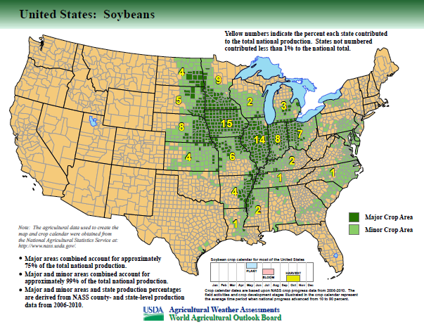
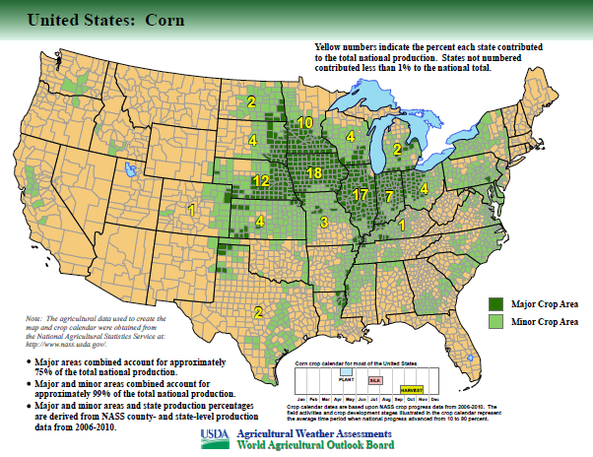
Supplier to the globe
This is where it is grown
U.S. is a leading soybean producer
Export near 50% of global soybeans and soybean products
Best logistics and infrastructure in the world for grain production
Time from Farm to Shanghai port is less than 29 days
24 of which is on the Ocean

Slide 18
Farm real estate bottoming?
Notes:
Bottoming?

Slide 19
Sustainable Value Lending
Compeer incorporates a lending method that values the collateral at a sustainable price rather than market price
Based on the long-run expectations of corn price and yield, and a 4% cap rate, sustainable value near $6,000 an acre
Loan based on 65% of sustainable value, not market value
Remaining portion funded with increased owners equity
Reduces volatility in valuations caused by short-run market fluctuations

Slide 20
Lending Standards: Land Values
*
*
* Note: 2017 Benchmark is Southern Minnesota only, whereas 2017 LTV is all of Compeer.
20
Notes:
AgStar did not include LTV for OTS loans in Cornerstone – So, historical numbers only include traditionally analyzed originations
Badgerland & 1st did include LTV for OTS – 2017 data includes the traditional, 1st & BL OTS but not AgStar OTS

Slide 21
Challenging environment for young & beginning producers
Younger borrowers have less ability to absorb significant losses – less margin for error
Compeer has dedicated lending programs in place to serve this market
Use of government guarantee programs lowers lending risk to the segment
Dedicated conferences and education opportunities to assist these clients in managing their risks while growing their business
Compeer’s average client
Source: University of Illinois

Slide 22
other industries
Dairy
Based on early 2018 prices, dairy operators will be unprofitable unless they contracted milk, current prices are more in-line with moderate losses
Regional variances
Agribusiness
Food processors and packers, branded companies, beverages and ethanol each experiencing solid margins and profits
Grain and crop input related companies profits lessened due to low commodity prices
Swine
The average swine producer was profitable in 2017, and these producers have recorded 4 straight years of profitability
Production is increasing, but export demand has been strong
Home Mortgage
Compeer is advancing a “Center of Excellence” within the Farm Credit System for rural home mortgage
$575mm managed portfolio in addition to $1.1bn in portfolio loans

Slide 23
regulatory Capital ratios
 | 2017 Actual | 2018 Budget | Board Target | “Well-Capitalized” Level
Common Equity Tier 1 | 14.2% | 14.6% | > 11% | 7.5%
Tier 1 | 14.7% | 15.1% | > 12% | 9.0%
Total Regulatory Capital Ratio | 15.1% | 15.5% | 14%* | 11.0%
T1 Leverage Ratio | 15.0% | 15.3% | > 12% | 5.4%
* Operating range of 13-15%. All other targets are “no less than” measures.
Notes:
Permanent capital includes all allocated equities, hence the reduction in 2018
Otherwise, all other capital ratios are increasing, and at or above the FIRs 1 level

Slide 24
Total Regulatory Capital Ratio

Slide 25
Capital Benchmarks
Note: Analysis of Compeer portfolio using AIRB practices. FMAC based on only Farm & Loan portfolio (excludes guarantees) and all capital.

